Slide 1
Lecture 1 Foundation of NET
Ren Liyong
School of SoftWare

Slide 2
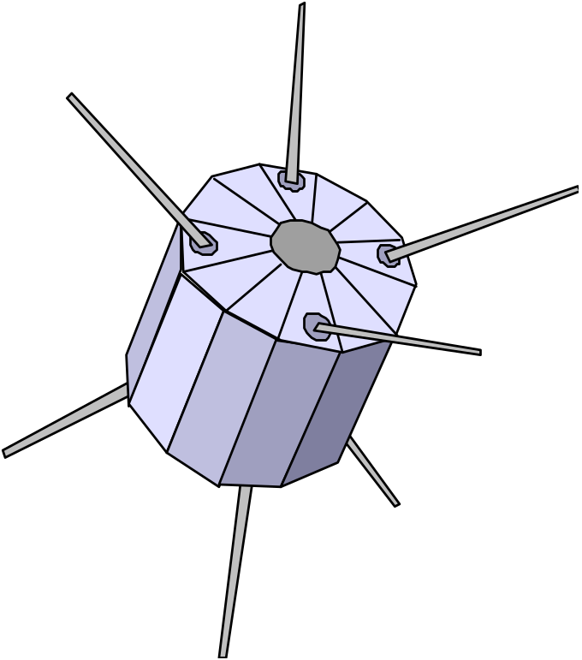
目 录
Foundation of NET
OSI/RM
TCP/IP

Slide 3
1、网络基础

Slide 4
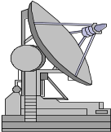
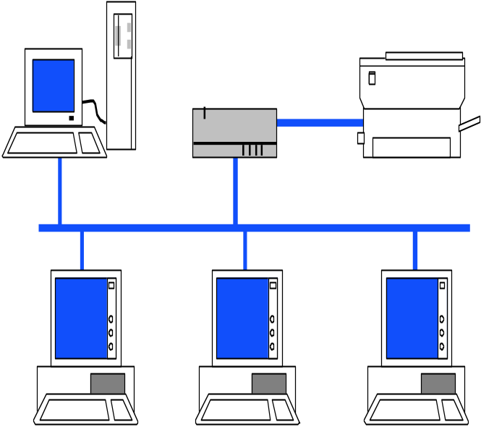
Networking
计算机网络：把分布在不同地理位置上的，具有独立功能的多台计算机、终端及其附属设备，用通信设备和通信线路连接起来，再配以相应的网络软件，以实现计算机资源共享。

Slide 5
LAN - Local Area Network
connects computers that are physically close together ( < 1 mile).
  high speed
  multi-access
Technologies:
  Ethernet 10 Mbps, 100Mbps
  Token Ring 16 Mbps
  FDDI 100 Mbps

Slide 6
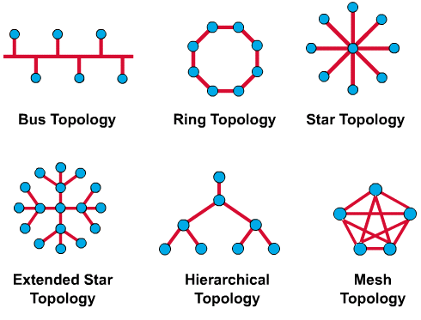
LAN物理拓扑结构

Slide 7
LAN逻辑拓扑结构
The logical topology of a network is how the hosts communicate across the medium. The two most common types of logical topologies are Broadcast and Token-passing.
Broadcast topology simply means that each host sends its data to all other hosts on the network medium.
Token-passing controls network access by passing an electronic token sequentially to each host. When a host receives the token, that means that that host can send data on the network.

Slide 8
WAN - Wide Area Network
connects computers that are physically far apart. “long-haul network”.
  typically slower than a LAN.
  typically less reliable than a LAN.
  point-to-point
Technologies:
  telephone lines
  Satellite communications

Slide 9
MAN - Metropolitan Area Network
Larger than a LAN and smaller than a WAN
  example: campus-wide network
  multi-access network
Technologies:
  coaxial cable
  microwave

Slide 10

Internetwork
Connection of 2 or more distinct (possibly dissimilar) networks.
Requires some kind of network device to facilitate the connection.
Net A
Net B

Slide 11
2、OSI Reference Model

Slide 12
OSI Reference Model
OSI/RM Layer Model
Application
Application
Presentation
Presentation
Session
Session
Transport
Transport
Network
Network
Data Link
Data Link
Physical
Physical
Network

Slide 13
The Physical Layer
Responsibility:
  transmission of raw bits over a communication channel.
Issues:
  mechanical and electrical interfaces
  time per bit
  distances

Slide 14
The Data Link Layer -
Data Link Control
Responsibility:
  provide an error-free communication link
Issues:
  framing (dividing data into chunks)
    header & trailer bits
  addressing
10110110101
01100010011
10110000001

Slide 15
The Network Layer
Responsibilities:
  path selection between end-systems (routing).
  subnet flow control.
  fragmentation & reassembly
  translation between different network types.
Issues:
  packet headers
  virtual circuits

Slide 16
The Transport Layer
Responsibilities:
  provides virtual end-to-end links between peer processes.
  end-to-end flow control
Issues:
  headers
  error detection
  reliable communication

Slide 17
The Session Layer
Responsibilities:
  establishes, manages, and terminates sessions between applications.
  service location lookup
Many protocol suites do not include a session layer.

Slide 18
The Presentation Layer
Responsibilities:
  data encryption
  data compression
  data conversion
Many protocol suites do not include a Presentation Layer.

Slide 19
The Application Layer
Responsibilities:
  anything not provided by any of the other layers
Issues:
  application level protocols
  appropriate selection of “type of service”

Slide 20
Layering & Headers
Each layer needs to add some control information to the data in order to do it’s job.
This information is typically prepended to the data before being given to the lower layer.
Once the lower layers deliver the the data and control information - the peer layer uses the control information.

Slide 21
Encapsulation
Process
DATA
Process
Transport
H
DATA
Transport
Network
H
H
DATA
Network
Data Link
H
H
H
DATA
Data Link

Slide 22
Network layer header - examples
protocol suite version
type of service
length of the data
packet identifier
fragment number
time to live
protocol
header checksum
source network address
destination network address
Notes:
我们是他们的好朋友

Slide 23
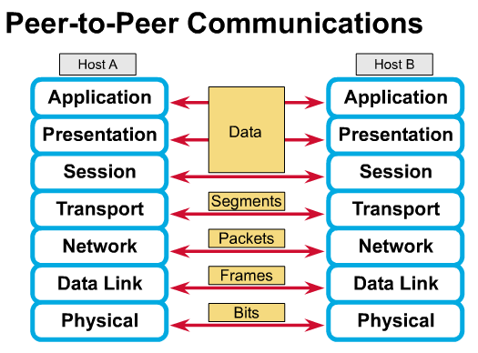
对等通信

Slide 24
Important Summary
Data-Link: communication between machines on the same network.
Network: communication between machines on possibly different networks.
Transport: communication between processes (running on machines on possibly different networks).

Slide 25
Connecting Networks
Repeater(Hub): physical layer
Bridge(Switch): data link layer
Router: network layer
Gateway: network layer and above.

Slide 26
Repeater
Copies bits from one network to another
Does not look at any bits
Allows the extension of a network beyond physical length limitations
REPEATER

Slide 27
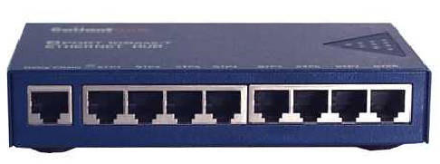
HUB：集线器
The purpose of a hub, also known as a multi-port repeater, is to amplify and re-time network signals, at the bit level, to a large number of users
Hubs are considered Layer 1 devices

Slide 28
Bridge
Copies frames from one network to another
Can operate selectively - does not copy all frames (must look at data-link headers).
Extends the network beyond physical length limitations.
BRIDGE

Slide 29
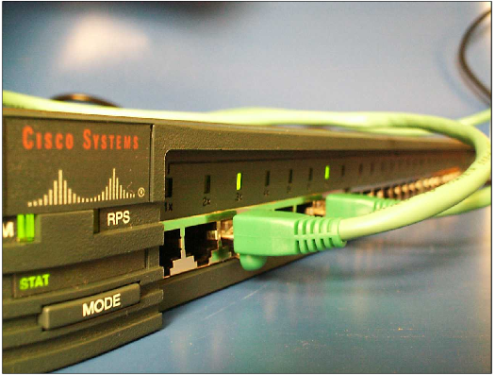
SWITCH: 交换机
The purpose of a switch is to concentrate connectivity, while guaranteeing bandwidth.
You might think of each port on a switch as a micro-bridge, which makes it a Layer 2 device.

Slide 30
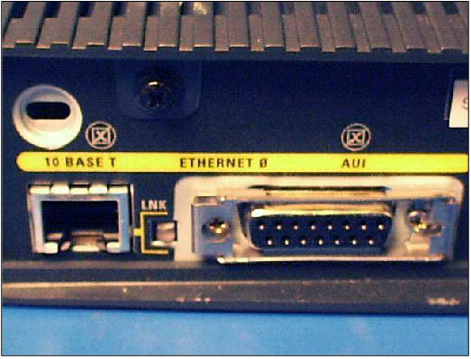
Router
Copies packets from one network to another.
Makes decisions about what route a packet should take (looks at network headers).
ROUTER

Slide 31
Gateway
Operates as a router
Data conversions above the network layer.
Conversions:
  encapsulation - use an intermediate network
  translation - connect different application protocols
  encryption - could be done by a gateway

Slide 32
Encapsulation Example
Gateway
Gateway
Provides service connectivity even though intermediate network does not support protocols.

Slide 33
Translation
Gateway
Translate from green protocol to brown protocol

Slide 34
Encryption gateway
Secure
Network
Secure
Network
Encryption/Decryption
Gateways
?
GW
?
GW
?
Insecure Network

Slide 35
Hardware vs. Software
Repeaters are typically hardware devices.
Bridges can be implemented in hardware or software.
Routers & Gateways are typically implemented in software so that they can be extended to handle new protocols.
Many workstations can operate as routers or gateways.

Slide 36
Byte Ordering
Different computer architectures use different byte ordering to represent multibyte values.
16 bit integer:
Low Byte
Address A
High Byte
High Byte
Address A+1
Low Byte

Slide 37
Byte Ordering
Little-Endian
IBM 80x86
DEC VAX
DEC PDP-11
Big-Endian
IBM 370
Motorola 68000
Sun
Low Byte
High Byte
High Byte
Low Byte
Addr A
Addr A+1
Addr A
Addr A+1

Slide 38
Byte Order and Networking
Suppose a Big Endian machine sends a 16 bit integer with the value 2:
A Little Endian machine will think it got the number 512:
0000000000000010
0000001000000000

Slide 39
Network Byte Order
Conversion of application-level data is left up to the presentation layer.
But hold on !!! How do lower level layers communicate if they all represent values differently ? (data length fields in headers)
A fixed byte order is used (called network byte order) for all control data.

Slide 40
Buffering
Buffering can provide more efficient communications.
Buffering is most useful for byte stream services.
Process A
Send
Buffer
Recv.
Buffer
Process B

Slide 41
Addresses
Each communication endpoint must have an address.
Consider 2 processes communicating over an internet:
  the network must be specified
  the host (end-system) must be specified
  the process must be specified.

Slide 42
Addresses at Layers
Physical Layer: no address necessary
Data Link Layer - address must be able to select any host on the network.
Network Layer - address must be able to provide information to enable routing.
Transport Layer - address must identify the destination process.

Slide 43
3、 TCP/IP参考模型

Slide 44
OSI vs TCP/IP
应用层
应用层
表示层
会话层
传输层
TCP
UDP
网络层
IPv4, IPv6
数据链路层
网络介质层
物理层
OSI模型
TCP/IP模型

Slide 45
通过路由器连接的两个网络
客户
服务器
FTP
客户
FTP协议
FTP
服务器
TCP
TCP协议
TCP
IP
IP协议
IP
IP协议
IP
以太网驱
动程序
以太网驱
动程序
令牌环驱
动程序
令牌环驱
动程序
以太网
令牌环

Slide 46
数据进入协议栈时的封装
用户数据
FTP
客户
App头部
用户数据
TCP
TCP头部
用户数据
TCP段
IP
IP头部
TCP头部
用户数据
IP分组
以太网驱
动程序
以太网
头部
IP头部
TCP头部
用户数据
以太网
尾部
以太网帧
40~1500字节

Slide 47
以太网数据帧分用过程
应用程序
应用程序
应用程序
应用程序
根据TCP或UDP
首部中的端口号
进行分用
TCP
UDP
ICMP
IGMP
根据IP首部中的
协议类型进行分用
IP
ARP
RARP
根据以太网首部中
的帧类型进行分用
以太网帧
进入的帧

Slide 48
TCP/IP协议族概貌
IPv4应用程序 AF-INET
IPv6应用程序 AF-INET6
tcpdump
mrouted
ping
traceroute
Appl.
Appl.
Appl.
Appl.
traceroute
ping
API
TCP
UDP
ICMP
IGMP
IPv4
IPv6
ICMPv6
ARP
RARP
BPF
DLPI
数据链路

Slide 49
UDP:用户数据报协议
UDP提供无连接服务
UDP缺乏可靠性支持，应用程序必须实现：确认、超时、重传、流控等
UDP面向记录服务

Slide 50
UDP数据报格式
#ifdef __FAVOR_BSD
struct udphdr {
u_int16_t uh_sport; /* source port */
u_int16_t uh_dport; /* destination port */
u_int16_t uh_ulen; /* udp length */
u_int16_t uh_sum; /* udp checksum */
};
#else
struct udphdr {
u_int16_t source;
u_int16_t dest;
u_int16_t len;
u_int16_t check;
};
#endif
0
15
31
源端口
目的端口
长度
校验和
数据

Slide 51
TCP：传输控制协议
TCP是面向连接的。
TCP提供可靠性，实现了丢失重传。RTT的估算。
TCP通过给所发送数据的每一个段管理一个序列号进行排序。
TCP提供流量控制和拥塞控制：通告窗口、拥塞窗口。
TCP的连接是全双工的。

Slide 52
TCP协议数据段格式
0
7
15
31
源端口
目的端口
序列号
确认号
首部
HLEN
保留
码位
窗口
校验和
紧急指针
选项
填充字节
数据区
数据
U
R
G
A
C
K
P
S
H
R
S
T
S
Y
N
F
I
N

Slide 53
TCP协议数据段格式（续）
struct tcphdr {
WORD SourPort;
WORD DestPort;
DWORD SeqNo;
DWORD AckNo;
BYTE HLen;
BYTE Flag;
WORD Window;
WORD ChkSum;
WORD UrgPtr;
/* Put options here. */
};

Slide 54
TCP协议数据段格式（续）
几个需要说明的字段
  HLEN：首部长度，以4字节（32位）为单位。tcp数据段首部包括固定和变长两部分；
  窗口：为通告窗口；
  URG位：如果使用紧急数据指针，则将这一位设为1
  ACK位：如果确认序列号有效，则设为1；
  PSH位：表示”推”数据，如果这一位设置成1，表示希望接收方在接收到这个数据段之后，将它立即传送给高层应用程序，而不是缓存起来。

Slide 55
TCP协议数据段格式（续）
  RST位：表示请求重置连接。当TCP协议接收到一个不能处理的数据段时，向对方TCP协议发送这种数据段，表示这个数据段所标识的连接出现了某种错误，请求对方TCP协议将这个连接清除。有3种情况可能导致TCP协议发送RST数据段（1）SYN数据段指定的目的端口处没有接收进程等待；（2）TCP协议想放弃一个已经存在的连接；（3）TCP接收到一个数据段，但是这个数据段所标识的连接不存在。接收到RST数据段的TCP协议立即将这条连接非正常断开，并向应用程序报告；

Slide 56
TCP协议数据段格式（续）
  SYN位：请求建立连接。tcp用这种数据段向对方tcp协议请求建立连接，在这个数据段中，tcp协议将它选择的初始序列号通知对方，并且与对方协议协商最大数据段的大小。
  FIN位：请求关闭连接。当协议收到对这个数据段的确认后，成功关闭写方向的连接，因为tcp连接是全双工的，在发送了FIN数据段之后，它仍能接收数据，直至对方也发送FIN数据段。
  紧急指针：如果设置了URG位，这个字段指出紧急数据相对于这个数据段的开始序列号的偏移量。tcp协议只提供一字节的紧急数据，但由于历史原因，紧急指针指向紧急数据的下一个位置。

Slide 57
TCP connection
Scenario when establishing TCP conn.：
  The Server must be ready。It is done by calling socket, bind, listen。Passive open。
  The Client issue active open by calling connect。The client TCP will send SYN, which tell initial sequence number.
  The server must ACK the SYN and must also send its own SYN.
  The client must ACK the server’s SYN.

Slide 58
TCP’s Three-way handshake
Client
Server
Socket
Connect(blocks)
(active open)
Socket,bind,listen
(passive open)
SYN J
SYN K, ack J+1
Connect return
ack K+1
Accept return
Read (blocks)

Slide 59
TCP connection termination
TCP takes four to terminate a connection
  One application calls close, The TCP sends a FIN，which means it is finished sending data. Active close.
  The received FIN is ACKed, and TCP will tell application as an end-of-file.
  Sometime later, the application that received end-of-file will close its sockets, which cause send FIN.
  The TCP ACK this FIN。

Slide 60
TCP connection termination
Client
Server
Close
(Active close)
FIN M
Passive close
Read return 0
ack M+1
Close
FIN N
ack N+1

Slide 61
Starting point
CLOSE
appl: passive open
send: <nothing>
appl: active open
Send: SYN
LISTEN
Recv :SYN；send: SYN,ACK
Recv :RST
SYN_RCVD
Recv :SYN Send :SYN,ACK,
simltaneous open
SYN_SENT
appl: close
or timeout
Recv :ACK
Send :<无>
Recv :SYN,ACK
Send :ACK
ESTABLISHED
CLOSE_WAIT
Recv :FIN
Send :ACK
Appl :close
appl: close
send: FIN
send: FIN
Simultaneous close
LAST_ACK
recv：ACK
send: <noting>
FIN_WAIT1
Recv :FIN
Send :ACK,
CLOSING
passive close
Recv :ACK
Send :<无>
Recv :ACK
Send :<nothing>
Recv ：FIN,ACK
Send :ACK
FIN_WAIT2
Recv :FIN
Send :ACK,
TIME_WAIT
2MSL timeout?
表示客户的状态转换
Active close
表示服务器的状态转换

Slide 62
Socket
Connect(blocks)
(active open)SYN_SENT
socket,bind,listen
LISTEN(passive open)
Accept (blocks)
SYN J, mss=1460
SYN K, ACK J+1, mss=1024
SYN_RCVD
ESTABLISHED
ACK k+1
ESTABLISHED
Accept returns
Read(blocks)
<client forms request>
Write
Read(blocks)
Data ( request)
Read return
<server proc. Req.>
Data( reply ) ACK of request
Write
Read (blocks)
Read(return)
ACK of reply
Close
(active close)FIN_WAIT1
FIN M
CLOSE_WAIT(pass. close)
Read reutrn 0
ACK M+1
FIN_WAIT2
Close
LAST_ACK
FIN N
TIME_WAIT
ACK N+1
2MSL
CLOSED
TCP连接中的分组交换

Slide 63
TCP 的TIME_WAIT状态
执行主动关闭的那端进入这种状态。这个端点在该状态的持续时间是2MSL（最长分节生命周期）。
存在TIME_WAIT状态有两个理由：
  实现终止TCP全双工连接的可靠性（假设最后一个ack丢失的情况）.
  允许老的重复分节在网络中消逝.

Slide 64
面向连接的
客户－服务器 模式
监听状态
等待连接
等待连接
发送请求
接受连接
接收、处理请求
接收处理结果
发送处理结果
关闭连接
服务器
客户

Slide 65

Network Address
Physical Addr.：MAC
Logic Addr.：IP
Port Addr.
Domain Addr.

Slide 66
物理地址
48位：24位OUI，24位由厂商分配
平面地址，无结构
全球唯一
局部范围寻址
存在于数据链路层

Slide 67
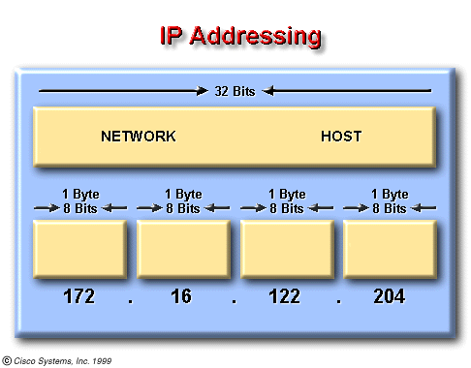
IP地址
IP地址标识着网络一个主机的位置。每个IP地址都是由32位（或128位）组成，分成两部分：网络号、主机号。
全球唯一，寻址容易
两种表示形式：二进制（计算机内部）、点分十进制（便于记忆）

Slide 68
IP地址分类
A
0
NetID
HostID
0~126
B
10
NetID
HostID
128~191
C
110
NetID
HostID
192~223
D
1110
Multicast Address
224~239
8 bits
8 bits
8 bits
8 bits

Slide 69
Class A
128 possible network IDs
over 4 million host IDs per network ID
Class B
16K possible network IDs
64K host IDs per network ID
Class C
over 2 million possible network IDs
about 256 host IDs per network ID

Slide 70
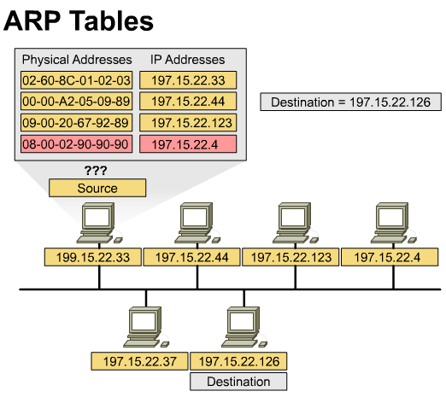
ARP：地址解析协议
IP地址不为机器硬件识别，因此数据发送与接收还必须靠物理地址。
ARP实现将IP地址转换为相应的物理地址。

Slide 71
ARP(Cont.)
HEY - Everyone please listen!
Will 128.213.1.5 please send me his/her Ethernet address?
not me
Hi Green! I’m 128.213.1.5, and my Ethernet address is 87:A2:15:35:02:C3

Slide 72
端口地址
process
process
process
process
process
process
IP地址平面

Slide 73
端口地址（cont.）
TCP和UDP使用16位的端口号（用无符号整型表示）
为防止端口使用的混乱，将端口分为以下三类：
  “众所周知”的端口：0~1023，由IANA统一控制
  注册的端口：1024~49151，这些端口虽不由IANA控制，但IANA登记这些端口的使用
  动态或私有的端口：49152~65535

Slide 74
网络中通信双方
网络中通信双方由以下四元组唯一确定：
  （协议、本地IP地址、本地端口号、远程IP地址、远程端口号）

Slide 75
DNS：域名地址
层次名字空间
便于记忆和使用
计算机通信时无法使用
域名地址解析：
  名字到IP地址的解析（gethostbyname）
  IP地址到域名的解析（gethostbyaddr）

Slide 76
DNS域名
顶级域名
edu
com
…
cn
…
edu
com
org
uestc

Slide 77
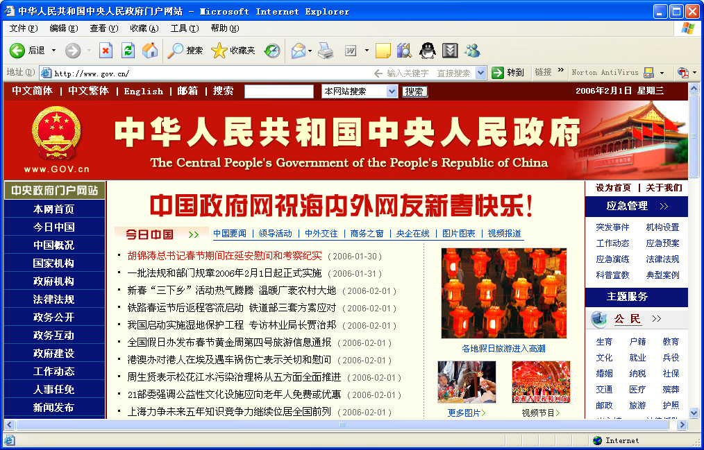
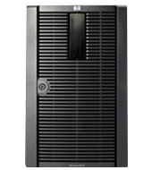
客户/服务器例子——WWW服务
互联网

Slide 78
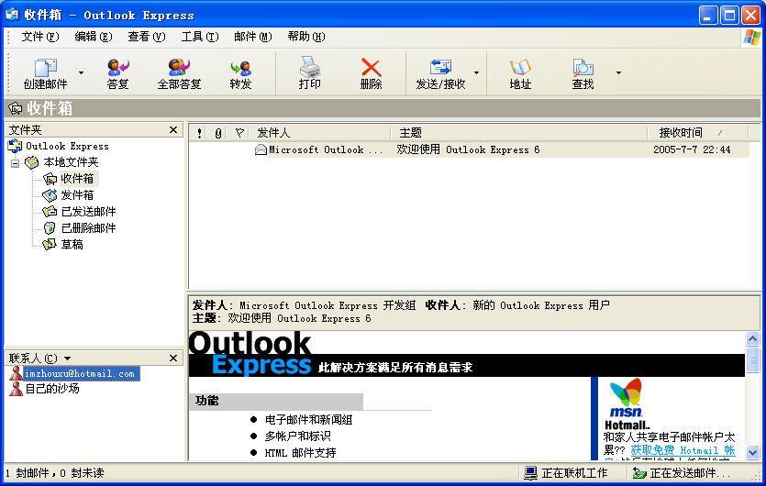
客户/服务器例子——EMail服务
互联网

Slide 79
客户/服务器模型：动机
TCP/IP规定了通信双方如何传递数据，但并没有规定什么时间以及为什么交互？
符合现实生活中的习惯
TCP/IP仅仅是传输数据的基本机制
客户/服务器主要解决：通信会聚问题
  同一时刻双方互发消息通信不可靠
  通信的一方启动执行后一直等待对方的联系更加可靠
  下层协议不必对收到的信息进行响应，减少了下层协议的复杂性

Slide 80
客户/服务器模型
简单的客户/服务器模型
1、连接请求
2、连接响应
1、数据请求
3、数据请求
S
C
S
C
2、数据响应
4、数据响应
5、关闭请求
无连接
6、关闭响应

Slide 81
复杂的客户/服务器模型
C
C
C
S
C
C

